Slide 1
KAIZEN PROPERTY MANAGEMENT presentation
DELIVERING PEACE OF MIND, AT AN AFFORDABLE PRICE

Slide 2
LICENSED BROKER PROFILE
Clyde R. Williams is the Owner/Managing Broker for Kaizen Property Management (KPM), which is a division of Kaizen Real Properties LLC (KRPs). He has been in the real estate industry for over 10 years, initially as an investor only, and then moved on to real estate sales and property management. He began acquiring his portfolio of property investments, which he purchased and managed; since 2009 and later transitioned into property management on a full time basis.
Mr. Williams is also a Condominium Board President in the city of Miramar and is a licensed Community Association Manager (LCAM). His education includes; MSc in Industrial/Petroleum Management, BSc Industrial Management, Technical Diplomas in Mechanical and Petroleum Engineering. He also holds the PMP designation (Project Management Professional); from the Project Management Institute, USA and the GRI designation (Graduate Realtor Institute); from the National Association of Realtors, Florida.

Slide 3
THE COMPANY
KAIZEN PROPERTY MANAGEMENT IS A FULL SERVICE PROPERTY MANAGEMENT COMPANY SPECIALIZING IN SINGLE FAMILY, CONDO, TOWNHOUSE, MULTI-FAMILY AND SELECTIVE COMMERCIAL PROPERTIES.
WE PROFESSIONALLY MAINTAIN, MARKET, PROCURE QUALIFIED TENANTS AND MANAGE THE DAILY OPERATIONS OF EACH PROPERTY.
OUR IN-HOUSE STAFF ENSURES EFFICIENT, AFFORDABLE REPAIRS AND WE SEEK THE BEST PRICES FROM QUALIFIED SERVICE PROVIDERS FOR ALL CONTRACT WORK.
OUR COMMITMENT TO EXCELLENT SERVICE IS CONTINUOUS, AND WE MANAGE ALL PROPERTIES AS IF THEY WERE OUR OWN.

Slide 4
OUR VISION
TO USHER IN A NEW ERA OF PROPERTY MANAGEMENT, BY OFFERING AFFORDABILITY AND UNMATCHED SERVICE DELIVERY; WHICH IS TRUSTED AND SOUGHT AFTER BY LANDLORDS AND TENANTS ALIKE. WHERE, WE LEAD AND OTHERS FOLLOW.

Slide 5
MISSION STATEMENT
CONTINUOUSLY IMPROVE OUR DAY TO DAY DELIVERY OF SERVICE TO LANDLORDS AND TENANTS, TO ENSURE UNSURPASSED PERFORMANCES IN ALL AREAS OF PROPERTY MANAGEMENT.

Slide 6
MAIN BUSINESS OBJECTIVES
To provide superior, affordable and reliable service that is sustainable in all economic environments.
To grow the company sufficiently; to make regional expansion a possibility and thereby creating an environment where franchise opportunities become available.

Slide 7
OUR BRAND “AFFORDABILITY, PROFICIENCY, EXPERIENCE, SERVICE”
PRICING:
Maintaining Affordable/Competitive Rates/Fees by:
Creative Cost Improvement.
Competitive Bidding Process (where necessary).
Job Price as opposed to Hourly Rates where feasible, for cost savings.
Keeping track of market data to ensure optimal rental rates for owners.
TENANT PLACEMENT:
Proficient in ensuring properly screened, high valued tenant(s) for each property.
MANAGEMENT SERVICE:
Property Management, Maintenance and Service Requests performed by well trained, Experienced and highly qualified personnel.
INFORMATION/PERSONNEL ACCESSIBILITY:
Creating an online presence, that allow landlords and tenants to have instant access to property information or online accounts and 24hr personnel accessibility for Service or emergency response requests.

Slide 8
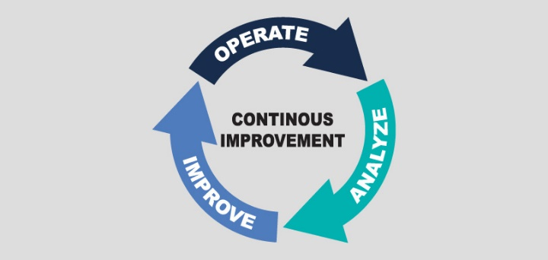
WHY KAIZEN ?
Licensed and Insured.
Affordable Management Fee: 6% of monthly rent collected. (Reduced or flat rates for multi units and periodic special promotion rates for single family units).
No Lease Renewal Fees.
Tenant Placement Fee: 50% to 100% of 1st month rent.
Owner receives rent within 24 – 72hrs.
No Vacancy Management Fee.
No Marketing Fees from Owner.
Timely Response to Service/Maintenance Requests.

Slide 9
WHY KAIZEN ? Cont’d
Zero Evictions for KPM placed Tenants.
Owner keeps pet fees.
No Hidden Fees / No Set-up Fees.
Annual Income Tax Documentation.
Available Monthly Income and Expense Report.
Online Access to Records 24/7/365.
Our Services are Tax Deductible.

Slide 10
THE KAIZEN ADVANTAGE
 | Kaizen | Others
Management Fee | Start at 6% or less | 7% - 10%
Lease Renewals ** | 0% | 10% - 50%
Set-up Fees | $0.00 | $75 - $300/unit
Site Visit Cost | $0.00 | $50 - $100/unit
Cancellation Fee | $0.00 | Up to $400/unit
Contract Commitment | Cancel Anytime | Bound to Contract
Inspections | 1 - 2 per year | 0 - 1 per year
L/Lord Listings | 3.0% - 4.0% | 5% - 6%
Move-in / Move-Out Docs | $0.00 | $25 - $50 Each Visit

Slide 11
ONGOING LANDLORD SERVICES
Provide periodic comparative market analysis.
Work to maximize rent amounts.
Work to minimize vacancy time, by ensuring fit for purpose tenants.
Although most repairs are conducted by Kaizen PM repair personnel; however, when the need arises, we negotiate with service/maintenance providers to get the best rates/prices for our clients.
We offer property investment counselling.
24hr access to Property Managers. Why?
Because we foster personalized relationships with our landlords and treat their properties as our own. Earning our landlords “trust” is very important to us.

Slide 12
SALES COMMISSION POLICY FOR LANDLORD LISTINGS
COMMISSION COMMISSION
(Co-op Broker Finds Buyer) (KRPs Find Buyer)
4% 3.0%

Slide 13
IMPROVING TENANT / PROPERTY MANAGER RELATIONSHIPS
Building Healthy Tenant and Property Manager Relationships, such that;
Tenants are more inclined to keep the property relatively neat and in
good repair; i.e. 1) Change A/C filters as required.
2) Pest control if needed.
3) Timely reporting of maintenance/repair needs.
4) Properly securing the property during absence.
5) Take care of all appliances, equipment and
fixtures.
Providing Tenants with Maintenance Tips and Maintenance Reminders.
Emergency Response Requirements/Contacts, Placed in Each Unit and 24hr Access to Property Management in case of Emergencies.
Providing Tenants with Online Access, to make rent payments, maintenance requests and view monthly payment history.

Slide 14
IMPROVING TENANT / PROPERTY MANAGER RELATIONSHIPS CONT’D
Timely response to Tenant Maintenance Requests.
Provide Tenants with a copy of the Tenant’s Handbook and/or Rules and Regulations in the case of a Condo Association or HOA Controlled Communities.
Encouraging Tenants to inform the Property Manager when they may be away from the property for extended periods.
Organizing at least one Social Event each year for Multi-Family Units/Complex, where permitted.

Slide 15
CONCIERGE SERVICES: For Owners Who Are Currently Managing Their Properties
Lease Preparation.
Tenant Screening & Placement Services.
Property Maintenance, Repair & Inspection Services.
Tenant Ready Services: I) Interior / Exterior Painting.
II) Carpet Cleaning /Shampooing.
III) Complete Home Cleaning.
Property Investment and Management Counseling.
Preparation of Lease Addendum for Pets.
Tenant Notices. Such as;
3 Day Notice to Pay Rent or Deliver Possession.
7 Day Notice of Non-Compliance.
15 Day Notice to Terminate Month to Month Lease.
Notice to Impose Claim on Security Deposit.
Lease Renewal & Non-Renewal Notices.

Slide 16
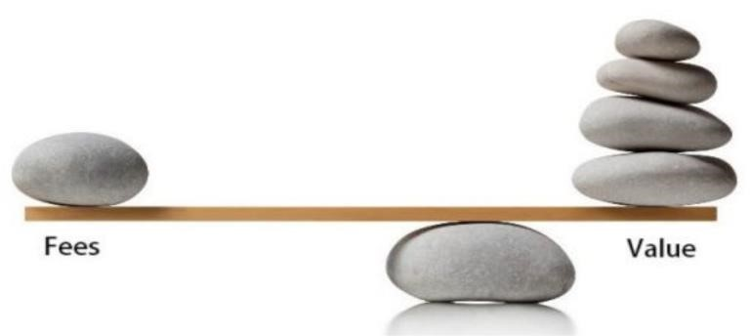
SCHEDULE OF FEES
Monthly Property Mgm’t Cost 6% of Monthly Rent or Fixed Price Per Month
Yearly Lease Renewals No Renewal Fees
Tenant Placement Fee 50%-100% of 1st month’s Rent
(Commission for
finding tenant when
property is vacant.)
Late Fees(s) All Late Fees are kept by Kaizen PM
Returned Check Fees All check fees are reimbursed to The Owner
Pet Fee(s) All Non-refundable Pet Deposits are kept by
The Owner
Vacant Property Mgm’t Fee None

Slide 17
SCHEDULE OF FEES CONT’D
Maintenance Fees Competitively Priced. (Many
jobs done on a Job Price basis to save costs)
Sales Commission Without co-op broker – 3 % Comm
(For selling property while (With co-op broker – 4.0 % Comm)
under management)
Advertising MLS, Zillow & over 100 other websites included
Move-in/Move Out Docs No Charge
Owner Payments Owners are paid monthly by EFT via the
Kaizen PM Website (A user/owner account is
established for each owner. (Owner receives
funds within 24-72hrs)

Slide 18
CONTACT INFORMATION
Clyde R. Williams (GRI, LCAM, PMP)
Managing Broker / Kaizen Real Properties LLC
20562 NW 10th Avenue, Miami, FL 33169
Phone : (o) 9547349883; (c) 9546483187
Email : clydewill245@gmail.com
https://kaizenrp.managebuilding.com
https://KaizenRealHomes.com
KAIZEN PROPERTY MANAGEMENT
DELIVERING PEACE OF MIND, AT AN AFFORDABLE PRICE

